Slide 1

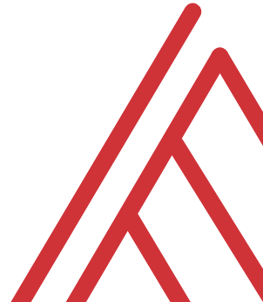
Introduction to R

Slide 2
Official learning objectives
Navigate the Rstudio integrated development environment
Load, view and modify data in R
Make simple graphical representations

Slide 3
Unofficial learning objectives
Making your work easier
Having fun with data
Not panicking!

Slide 4
Introduction to R

Slide 5
Background (Wikipedia)
“R is an open source programming language and software environment for statistical computing and graphics that is supported by the R Foundation for Statistical Computing.
The R language is widely used among statisticians and data miners for developing statistical software and data analysis.”

Slide 6
What R is and is not
R is…
A programming language
A statistical package
Open-source

Slide 7
What R is and is not
R is…
A programming language
A statistical package
Open-source
R is not…
A database
A spreadsheet
Commercially supported

Slide 8
Advantages of R
It’s free
It’s powerful
It’s popular

Slide 9
Advantages of R
“In our first run of these rankings, R placed 17th. All these years later it jumps two spots from the last quarter’s edition up to #13. In the interim, it has ranked as high as 12th but mostly commonly is found in the 13-15 range. Given the language’s specialized focus, this is likely its effective ceiling, but it’s also an illustration of the remarkable popularity of a language whose usage is restricted for all intents and purposes to a single domain – those who work with and operate on data.”
--RedMonk Programming Language Rankings, January 2020
https://redmonk.com/sogrady/2020/02/28/language-rankings-1-20/

Slide 10
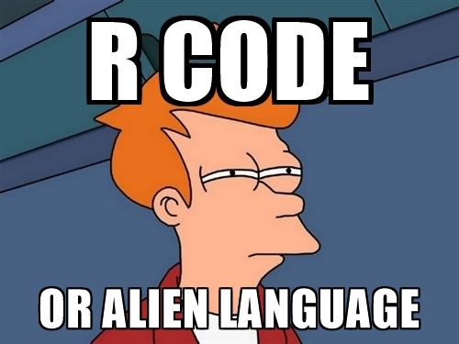
Disadvantages of R

Slide 11
Questions?

Slide 12
A Tour of R and RStudio

Slide 13
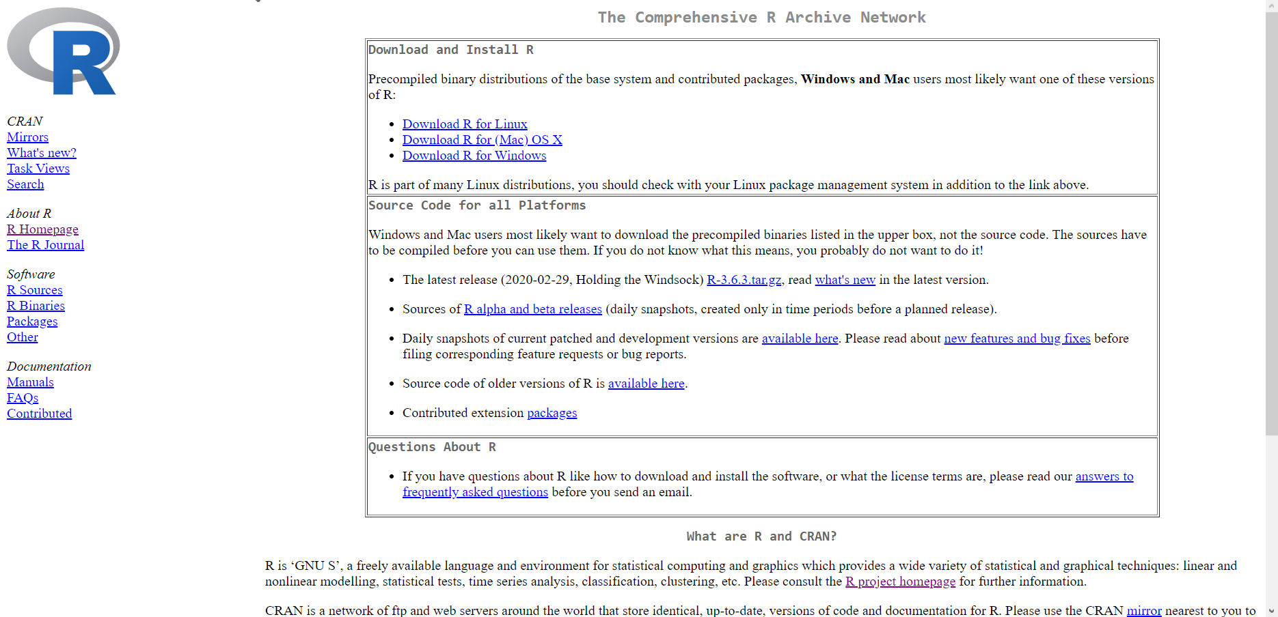
Base R and R packages
R’s source code: cran.r-project.org
“Ships” with data management, analysis and visualization tools

Slide 14
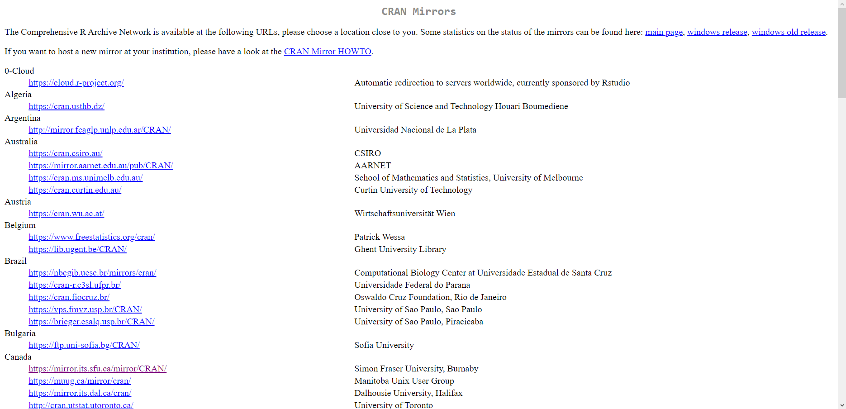
R: Download from a mirror near you
https://cran.r-project.org/mirrors.html

Slide 15

R packages: “There’s an App for that!”
Install the package
Open the package

Slide 16
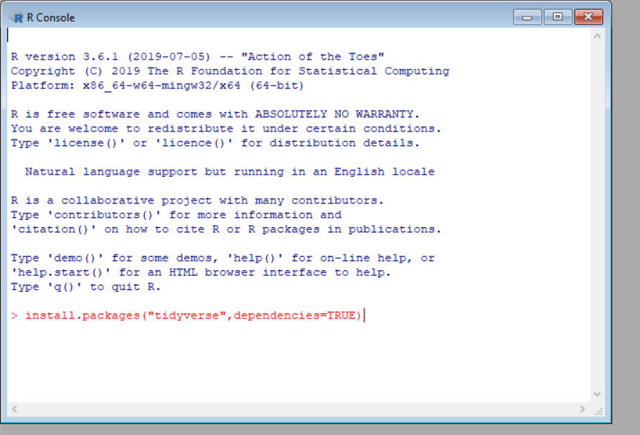
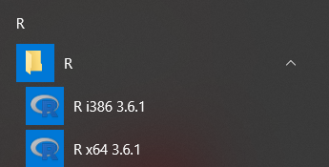
Installing the tidyverse package

Slide 17
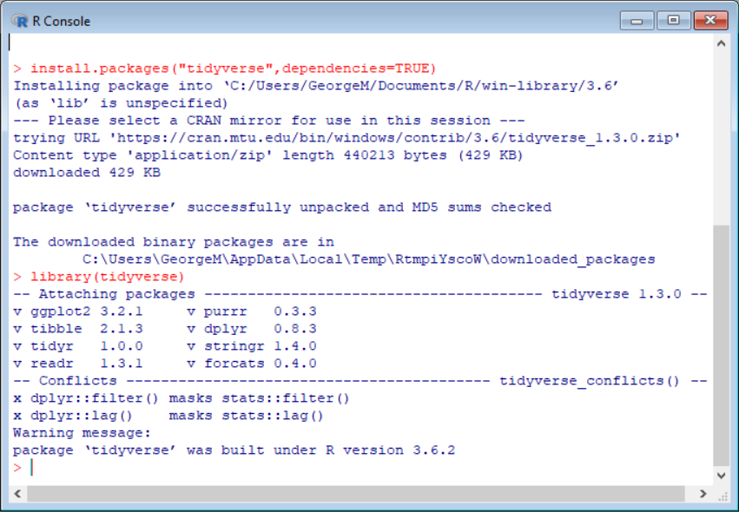
Loading the tidyverse package

Slide 18

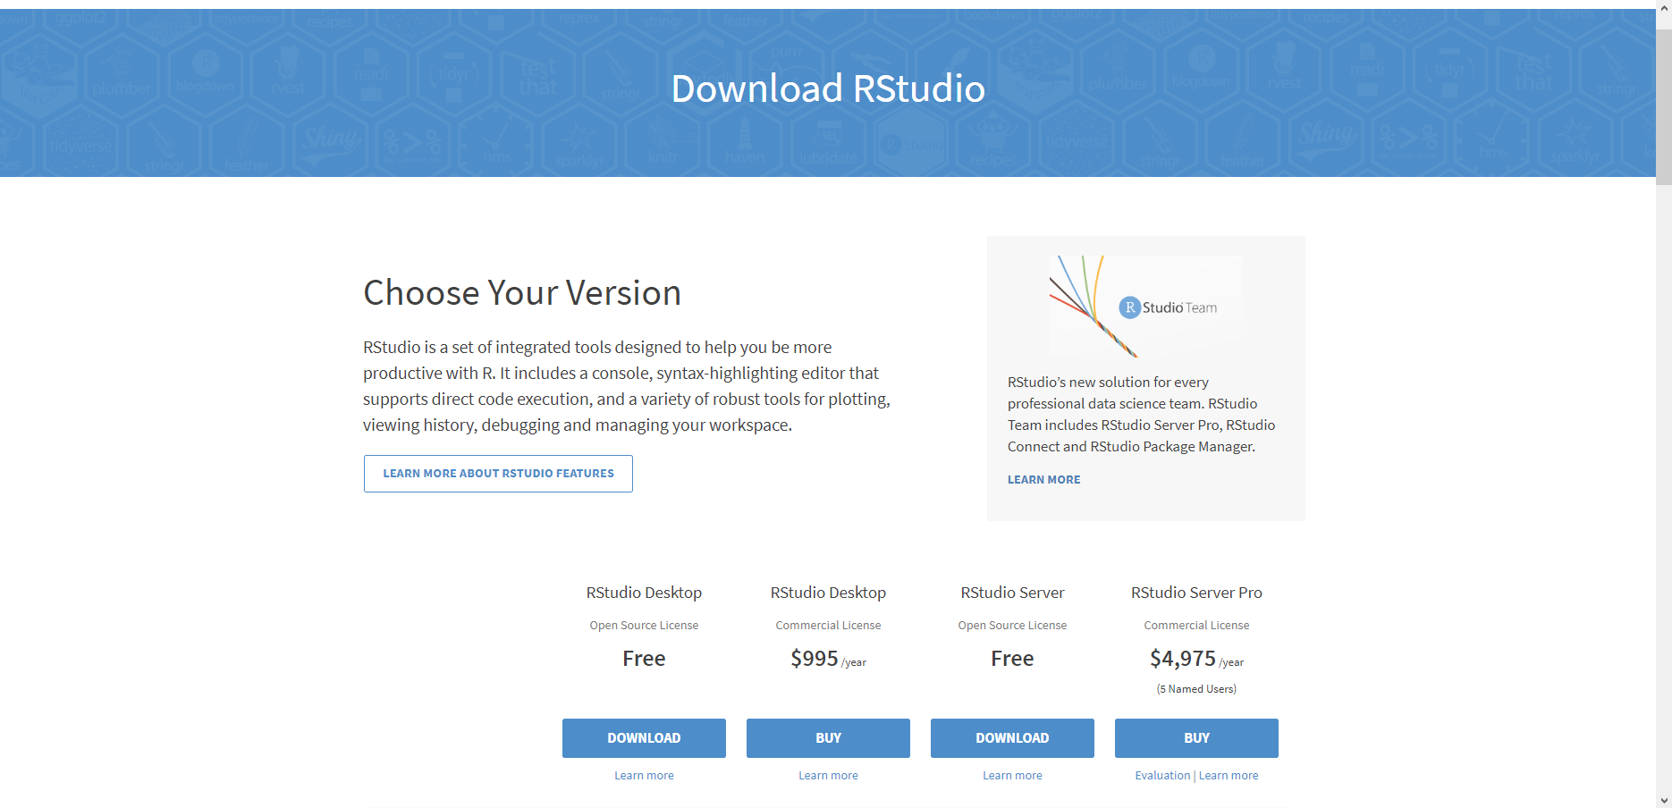
Let’s run in RStudio
https://rstudio.com/products/rstudio/download/

Slide 19
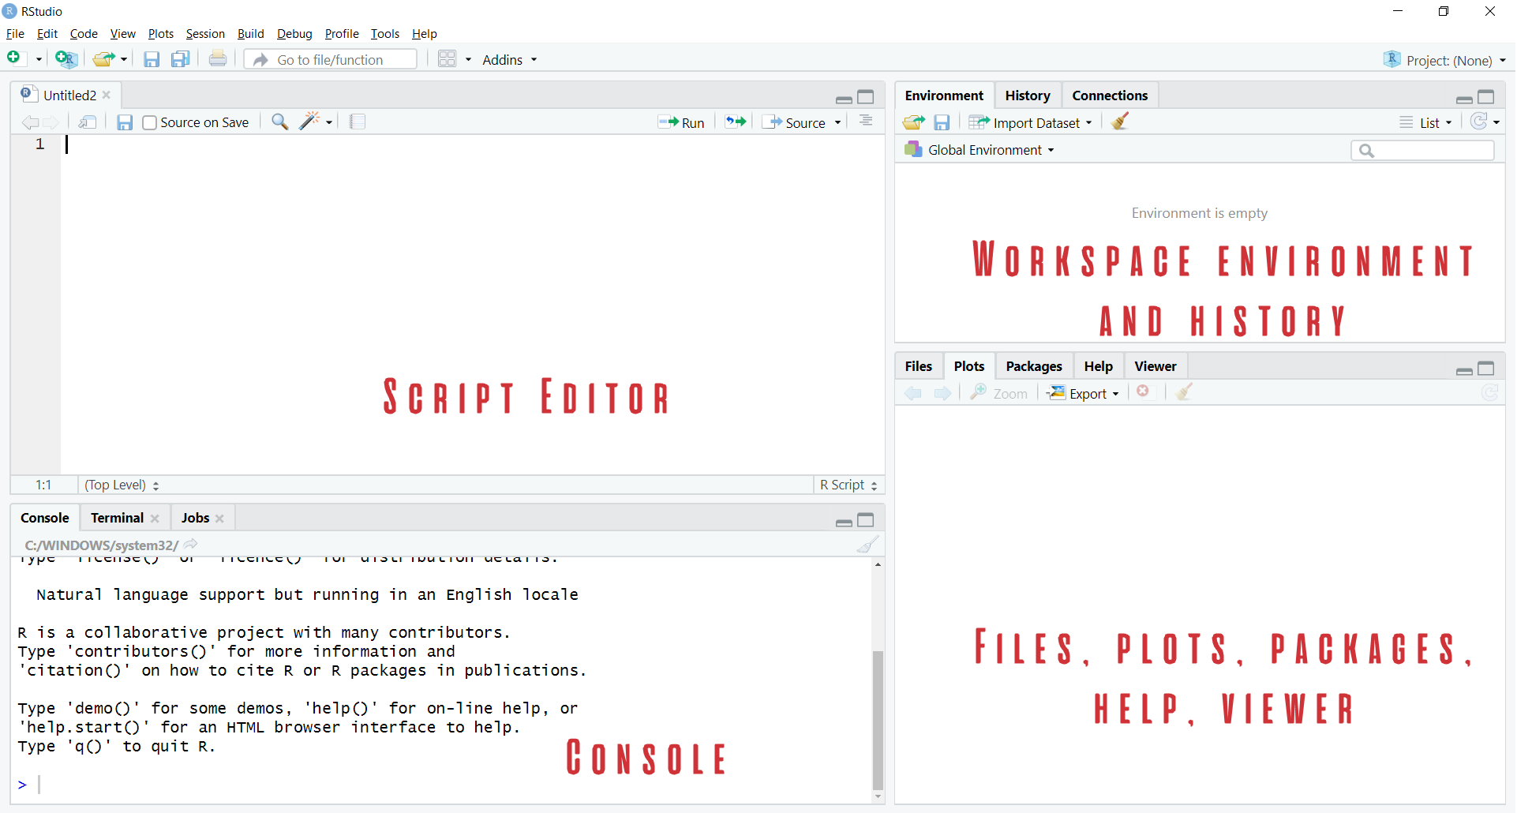
Rstudio Orientation

Slide 20
The two basic things to do in R
Run a function
Create or modify an object

Slide 21
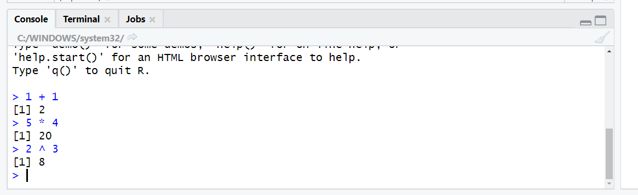
Let’s get working in the console
Use R as a fancy calculator:
Hit Enter to execute

Slide 22
R follows the order of operation and uses scientific notation:
2+3*4/(5+3)*15/2^2+3*4^2
## [1] 55.625
5e4
## [1] 50000

Slide 23
Testing conditions
Condition | Symbol
Equal to | == (not = )
Not equal to | !=
Greater than/less than | >, <
Greater than or equal to/less than or equal to | >=, <=
# Does 5 equal 4?
5 == 4
## [1] FALSE
# Is 10 less than or equal to 11?
10 <= 11
## [1] TRUE
#is the sqrt of 36 equal to 6 squared?
sqrt(36) != 6
## [1] FALSE

Slide 24


Using functions
sqrt(36)
## [1] 6
abs(-5*2)
## [1] 10

Slide 25
R is case-sensitive:
Sqrt(10)
## Error in Sqrt(10): could not find function "Sqrt"

Slide 26
Using functions
sqrt(36)
## [1] 6
abs(-5*2)
## [1] 10

Slide 27
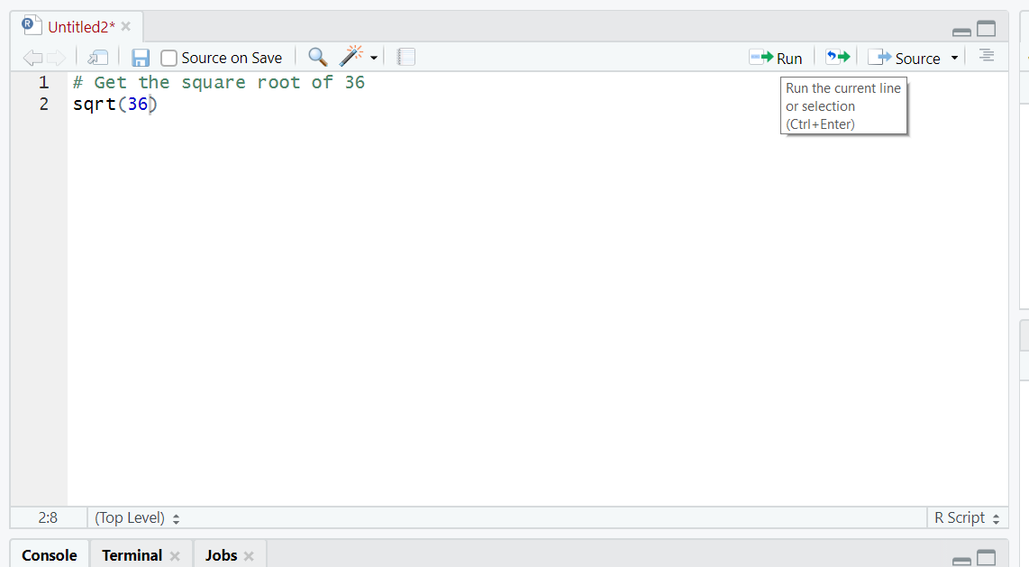
Script: save your code for later

Slide 28
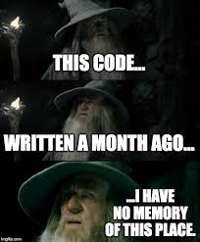
Note to self: use comments (#)

Slide 29
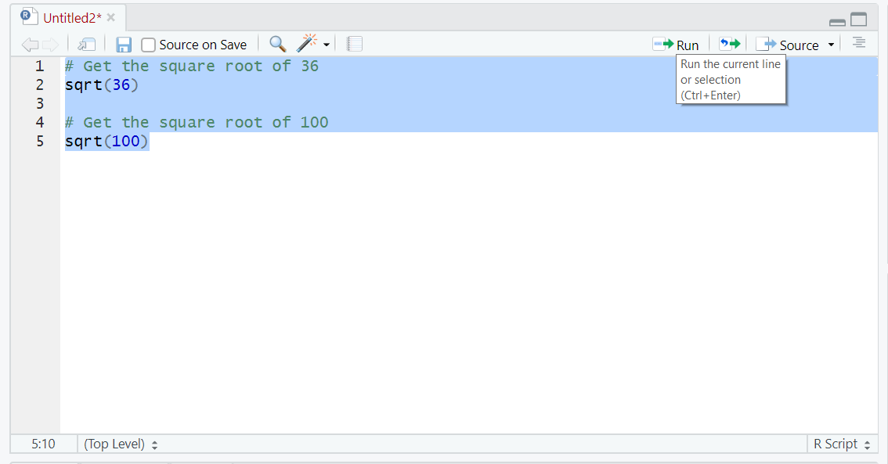
Execute multiple lines

Slide 30
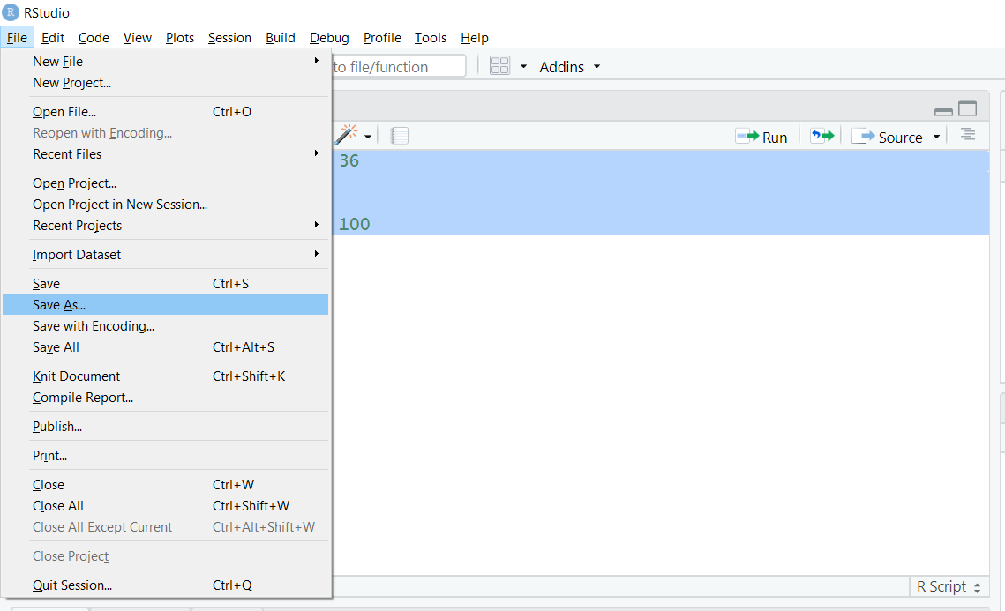
Save your work

Slide 31
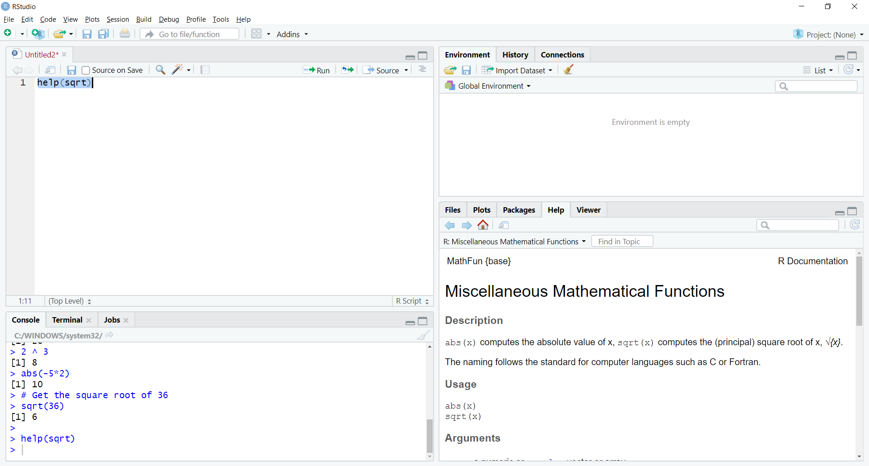
Getting Help (Lower right)

Slide 32
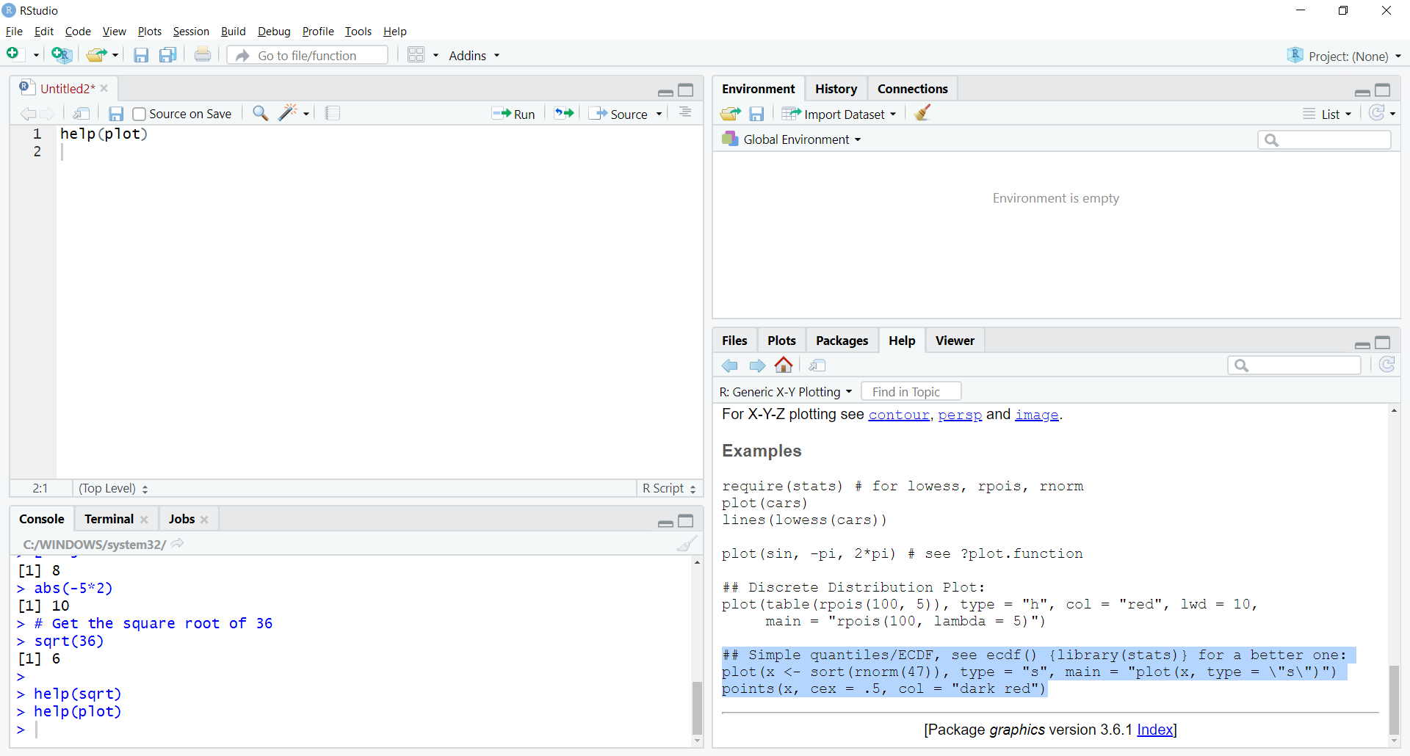
Plotting an example

Slide 33
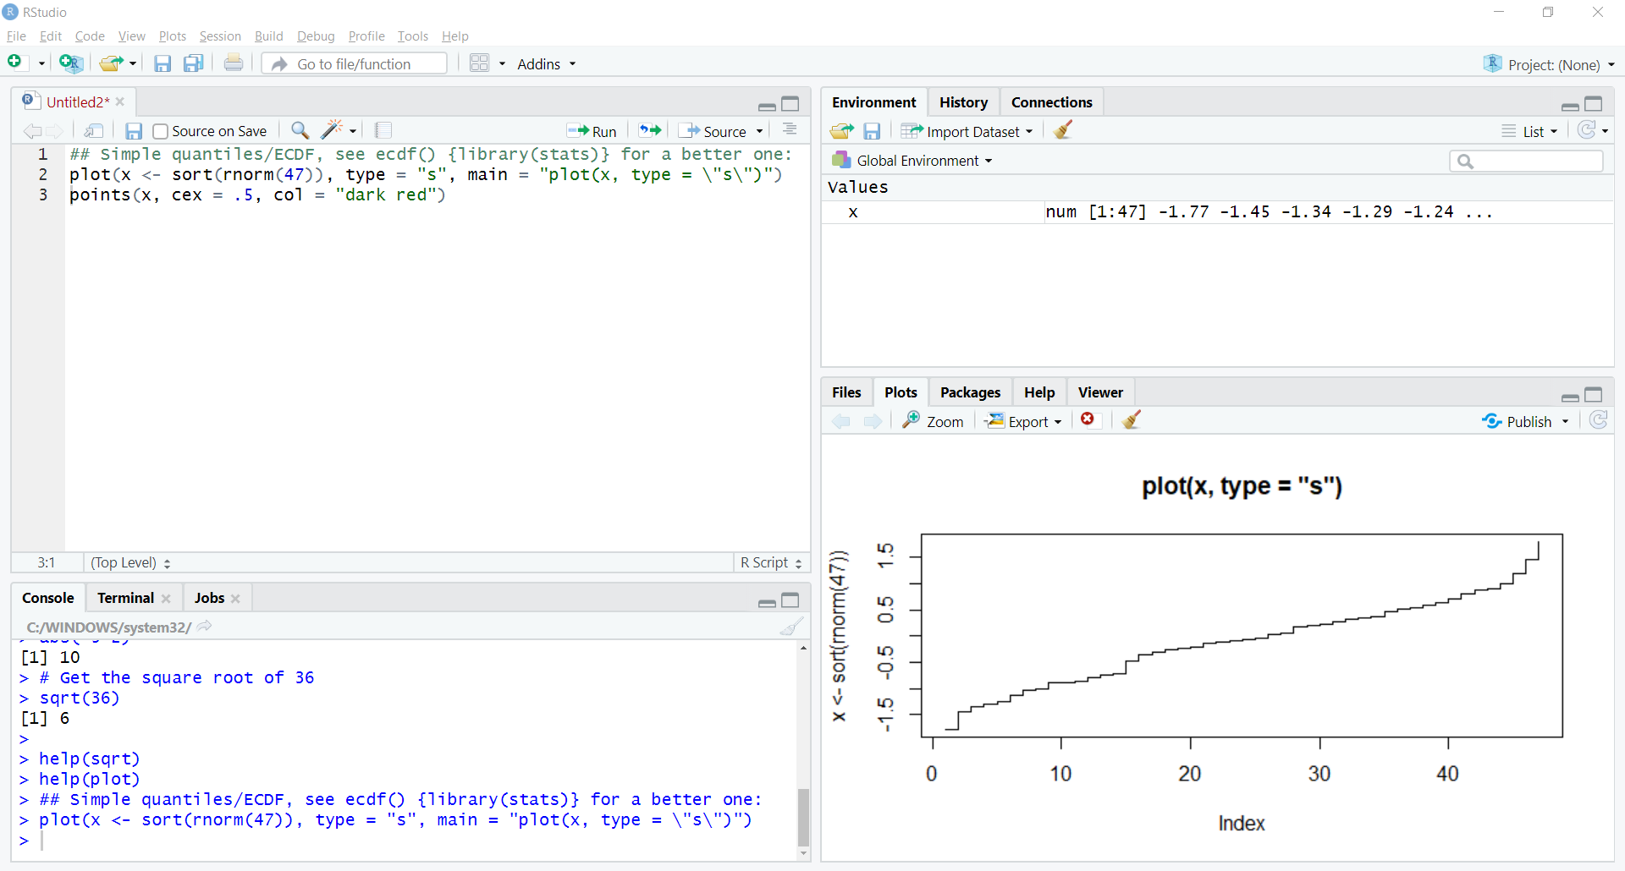
Plotting an example

Slide 34
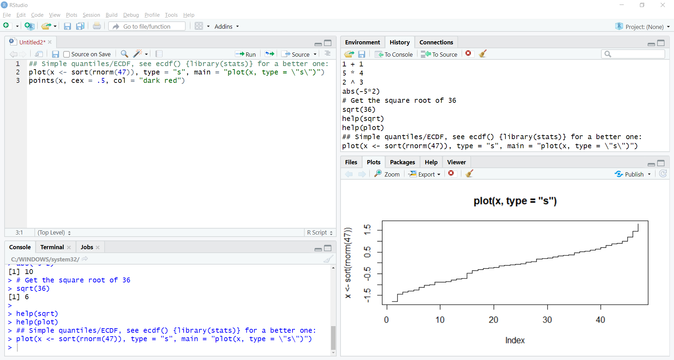
Viewing “R” history

Slide 35
Where did x come from? Us!

Slide 36
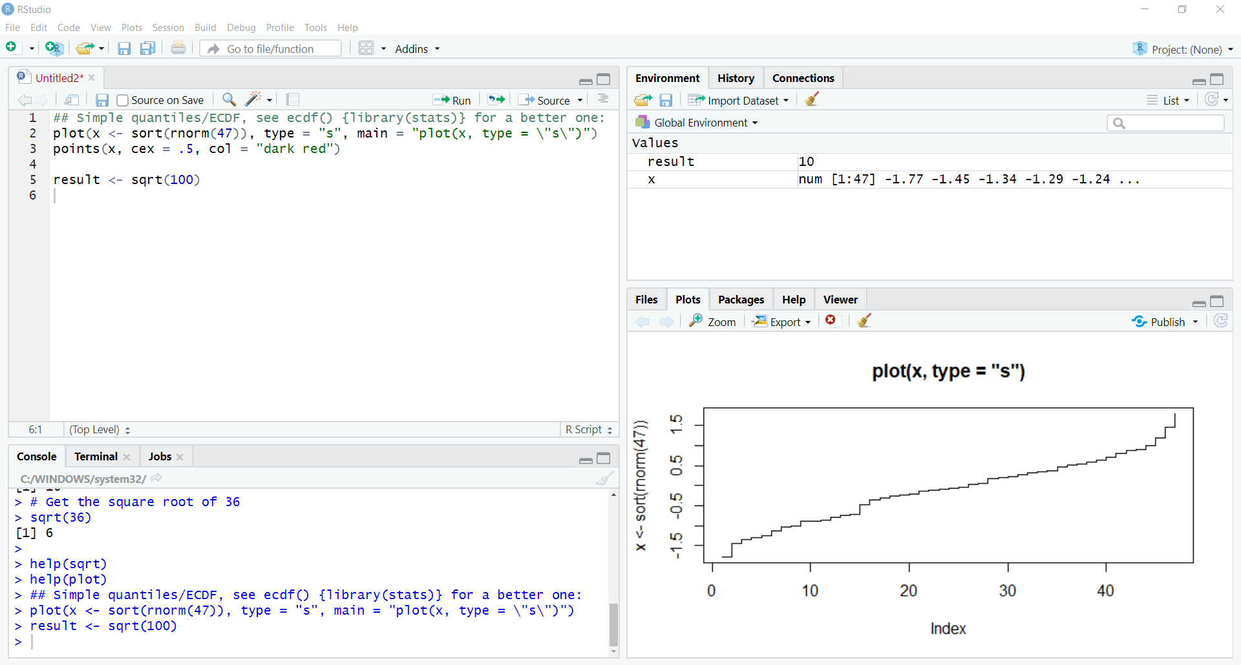
Assigning another object

Slide 37
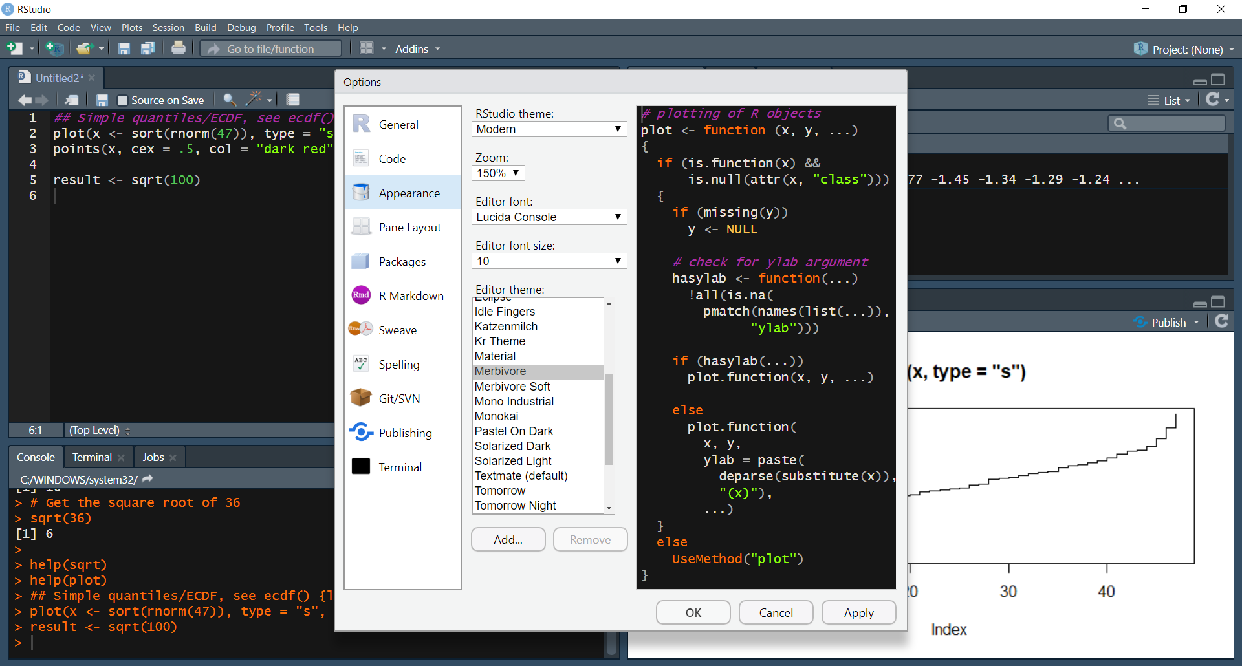
Now for something fun…

Slide 38
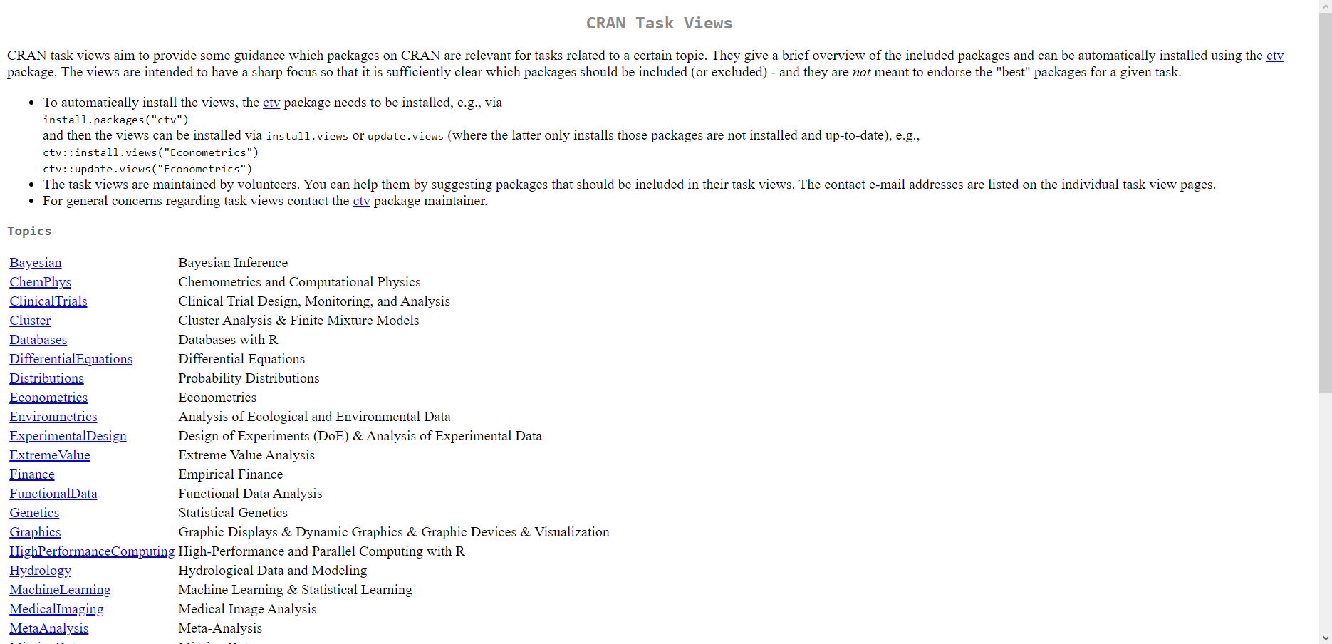
Spinning package playlists: CRAN task Views
https://cran.r-project.org/web/views/

Slide 39
ctv: a package to install other packages:
# Install task views package
install.packages("ctv")
# Load task views package
library(ctv)
# Install Econometrics task view
install.views("Econometrics")

Slide 40
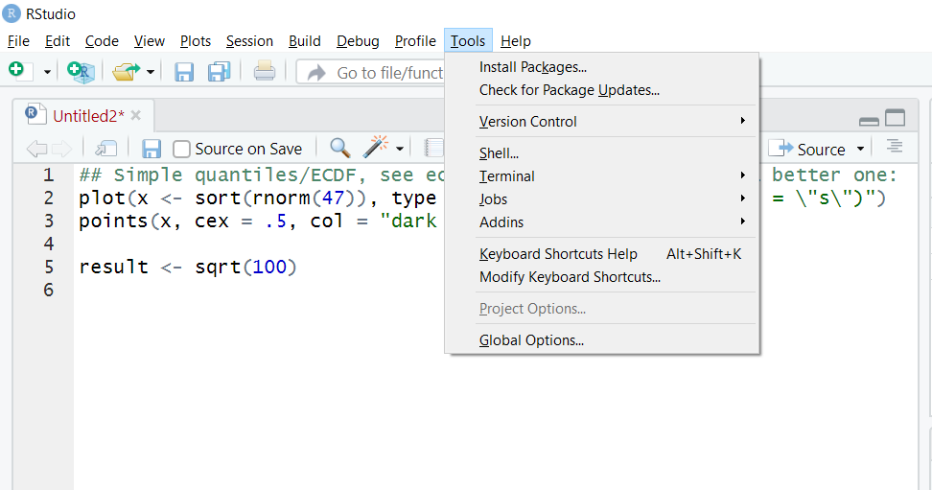
Checking for package updates

Slide 41
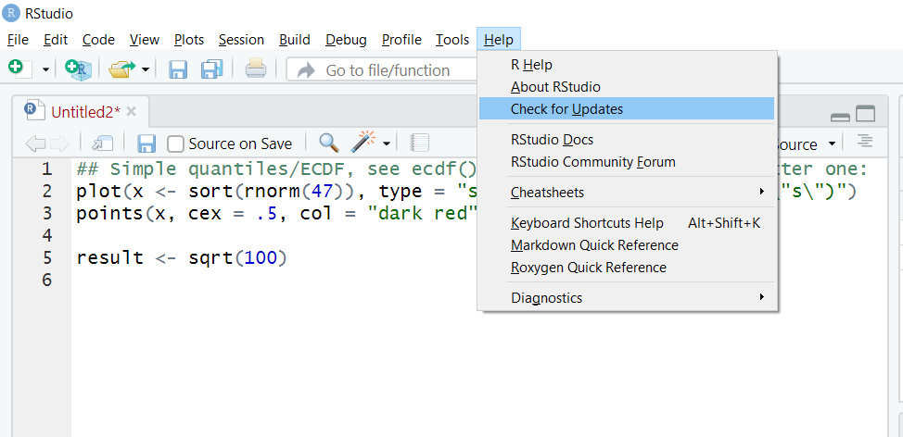
Checking for Rstudio updates

Slide 42

DRILLS
Load the tidyverse package
Call the help documentation on the subset() function
Install the ExtremeValue task view

Slide 43
Questions?

Slide 44
Data Types

Slide 45
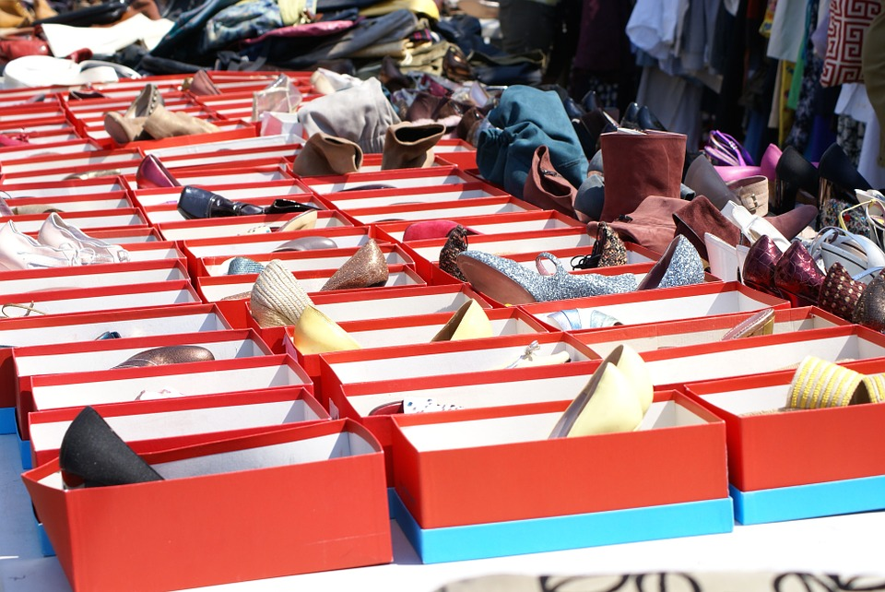
Creating objects
R stores data and output in objects

Slide 46
Creating objects
One option: equals sign (=)
#assign the value of the square root of 100 to
#the object, variable 'result'
result = sqrt(100)

Slide 47
Creating objects
Another (preferred) option: <- (Alt + M)
#assign the value of the square root of 100 to
#the object, variable 'result'
result <- sqrt(100)

Slide 48
Printing objects
#assign the value of the square root of 100 to
#the object, variable 'result'
result <- sqrt(100)

Slide 49
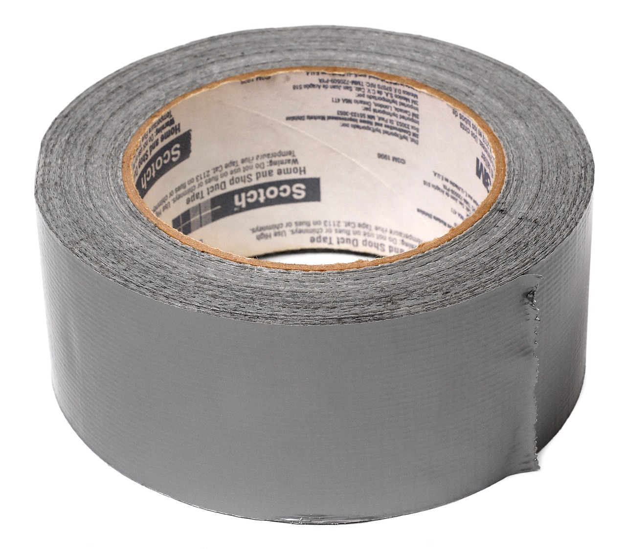

FROM VLOOKUP() DUCT TAPE TO JOIN() BLOWTORCH

Slide 50
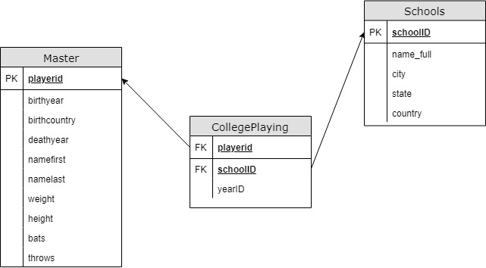
Introducing schemas

